Slide 1

HOLIDAY TRIP PLANNER
GROUP J:
1)HARSH VARDHAN (IIT2015045)
2)ROHAN RAYARADDI (IIT2015032)
3)RAGHAV SABOO (IIT2015042)
4)NISHANT VERMA (IIT2015039)

Slide 2
INTRODUCTION

Slide 3


Slide 4

Relaxation from work
Life is so busy now that we all need time to switch off. Whether that means sitting by a pool or dancing the night away; you need to leave your worries behind you, let off some steam and have a good time on holiday.

Slide 5

FAMILY TIME
Holidays are the best time to talk, there are no distractions and you can plan for the future or talk about experiences you have been having (good or bad ) without the tv on, phone ringing or the office getting in the way.

Slide 6

REJUVINATION
Even if your holiday is months away, you will think about it so often and it may get you through difficult times by just knowing you will be lying on a beach in the near future…

Slide 7
AIM
To allow people to choose and plan their holiday effortlessly.
Application provides popular attractive destinations for family holidays, hotels, best places to visit and photos of those locations to make it easier for customers to decide.

Slide 8
TOOLS USED
JAVA FXML
1)For creating front-end
MYSQL
1)For back-end
ERD PLUS
1)For creating e-r diagram
2)For creating relationship schema

Slide 9
E-R DIAGRAM
ENTITITIES USED
1)Customer
2)Hotel
3)Rooms
4)Day_Plan
5)Hotel_Images
6)Tourist_spot
7)Toursit_spot_images

Slide 10
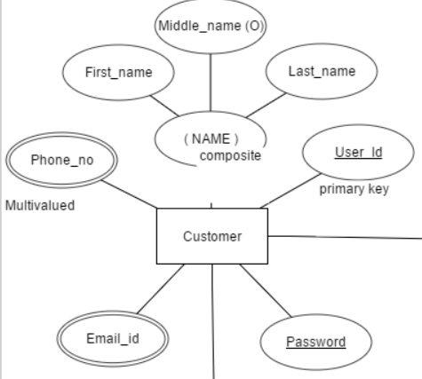
Customer
FIELD NAME | DATA TYPE | CONSTRAINTS
NAME | VARCHAR | NOT NULL
PHONE_NO | INT | NOT NULL
EMAIL_ID | VARCHAR | NOT NULL
USER_ID | VARCHAR | PRIMARY_KEY
PASSWORD | VARCHAR | UNIQUE

Slide 11
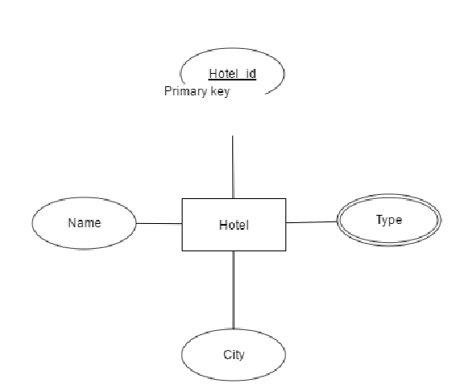
HOTEL
FIELD NAME | DATA TYPE | CONSTRAINTS
NAME | VARCHAR | NOT NULL
HOTEL_ID | VARCHAR | PRIMARY KEY
CITY | VARCHAR | NOT NULL
TYPE | VARCHAR | NOT NULL
Type

Slide 12
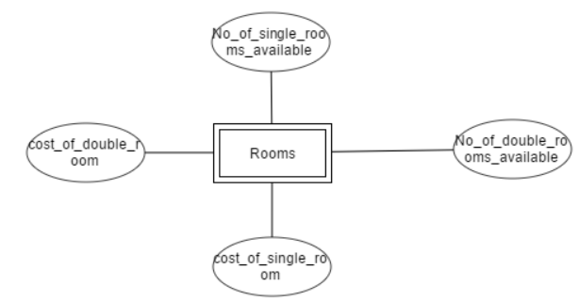
ROOMS
FIELD NAME | DATA TYPE | CONSTRAINT
COST(SINGLE) | INT | NOT NULL
COST(DOUBLE) | INT | NOT NULL
AVAILABLE (SINGLE) | INT | NOT NULL
AVAILABLE (DOUBLE) | INT | NOT NULL

Slide 13
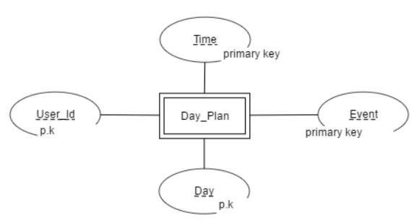
DAY_PLAN
FIELD NAME | DATA TYPE | CONSTRAINTS
TIME | TIME | UNIQUE
EVENT | VARCHAR | UNIQUE
USER_ID | VARCHAR | FOREIGN KEY
DAY | DATE | UNIQUE

Slide 14
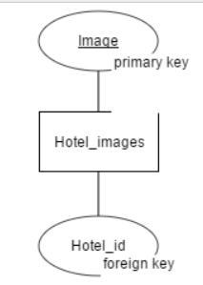
HOTEL_IMAGES
FIELD NAME | DATA TYPE | CONSTRAINT
IMAGE | BLOB | PRIMARY KEY
HOTEL_ID | VARCHAR | FOREIGN KEY

Slide 15
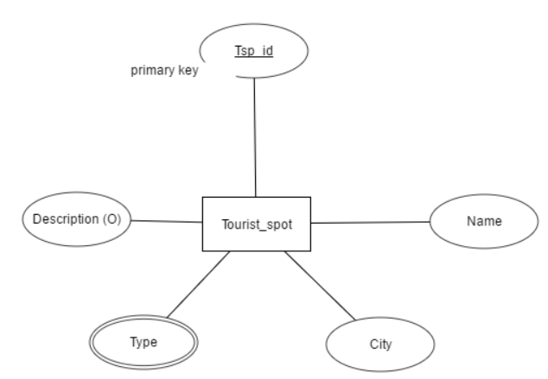
TOURIST_SPOT
FIELD NAME | DATA TYPE | CONSTRAINT
NAME | VARCHAR | NOT NULL
CITY | VARCHAR | NOT NULL
TYPE | VARCHAR | NOT NULL
DESCRIPTION | VARCHAR | NOT NULL
TSP_ID | VARCHAR | PRIMARY KEY

Slide 16
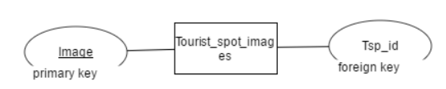
TOURIST_SPOT_IMAGES
FIELD NAME | DATA TYPE | CONSTRAINT
IMAGE | BLOB | PRIMARY KEY
TSP_ID | VARCHAR | FOREIGN KEY

Slide 17
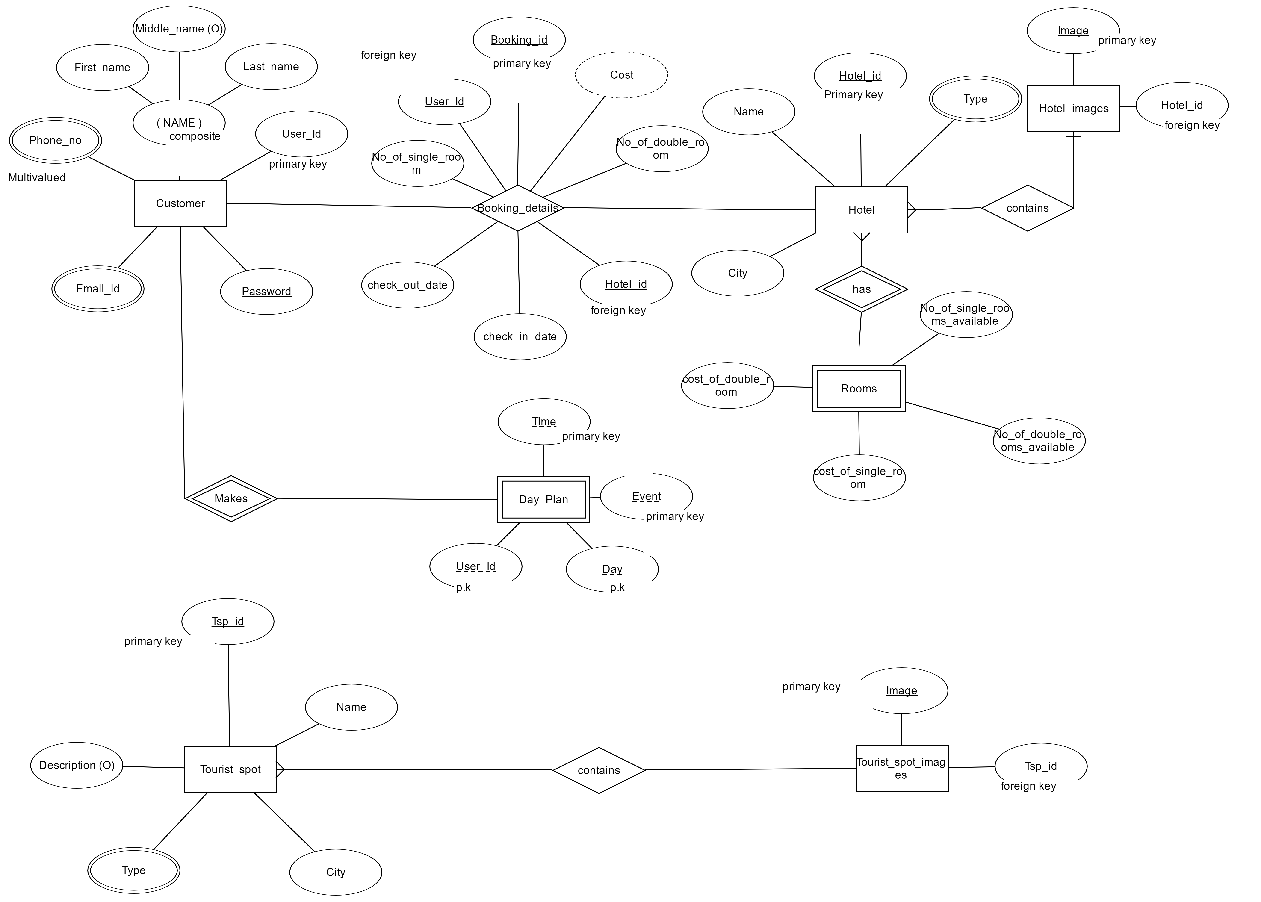

Slide 18
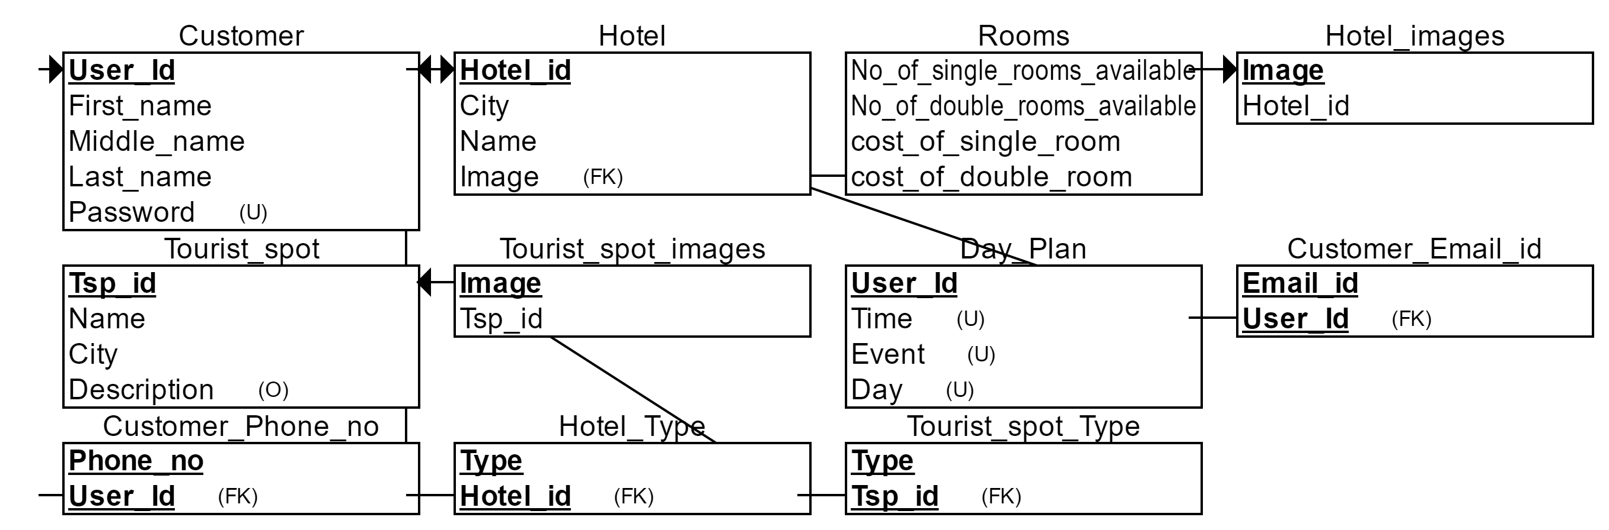
Relational schema

Slide 19
normalization
Normalization is a process of organizing the data in the database to avoid:-
* data redundancy
* insertion anomaly
* update anomaly
* deletion anomaly

Slide 20
1NF : 1st Normal Form
Criteria
All attributes must be single-valued: no repeating groups
There must be no composite attributes
Test
Evidently, all attributes are single-valued
No attributes are composite

Slide 21
HOTEL(CITY,NAME,COST_OF_SINGLE_ROOM,COST_OF_DOUBLE_ROOM,
NO_OF_SINGLE_ROOM,NO_OF_DOUBLE_ROOM,TYPE,HOTEL_ID,
IMAGE)
FUNCTIONAL DEPENDENCY
HOTEL_ID->CITY
HOTEL_ID->NAME
HOTEL_ID->COST_OF_SINGLE_ROOM

Slide 22
HOTEL_ID->NO_OF_SINGLE_ROOM
HOTEL_ID->COST_OF_DOUBLE_ROOM
HOTEL_ID->NO_OF_DOUBLE_ROOM
HOTEL_ID->TYPE
HOTEL_ID->IMAGE
IMAGE->HOTEL_ID

Slide 23
HOTEL
CITY | NAME | CSR | CDR | NSR | NDR | TYPE | HOTEL_ID | IMAGE
VARCHAR NOT NULL | VARCHAR NOT NULL | INT NOT NULL | INT NOT NULL | INT NOT NULL | INT NOT NULL | VARCHAR NOT NULL | VARCHAR | BLOB PRIMARY KEY
TOURIST_SPOT(TSP_ID,NAME,CITY,DESCRIPTION,TYPE,IMAGE)
FUNCTIONAL DEPENDENCY
TSP_ID->NAME
TSP_ID->CITY
TSP_ID->DESCRIPTION

Slide 24
TSP_ID ->TYPE o IMAGE->TSP_ID
IMAGE->NAME
TOURIST_SPOT
TSP_ID | NAME | CITY | DESCRIPTION | TYPE | IMAGE
VARCHAR PRIMARY KEY | VARCHAR NOT NULL | VARCHAR NOT NULL | VARCHAR NOT NULL | VARCHAR NOT NULL | BLOB UNIQUE

Slide 25
CUSTOMER(NAME,USER_ID,PASSWORD,PHONE_NO,EMAIL_ID,BOOKING_ID,NO_OF_
SINGLE_ROOM,NO_OF_DOUBLE_ROOM,COST,HOTEL_ID,CHECK_IN,
CHECK_OUT)
FUNCTIONAL DEPENDENCY
O USER_ID->NAME o BOOKING_ID->NSR
O USER_ID->PASSWORD o BOOKING_ID->NDR
O USER_ID->EMAIL_ID o BOOKING_ID->COST
O USER_ID->PHONE_NO o BOOKING_ID->HOTEL_ID
O BOOKING_ID->USER_ID o BOOKING_ID->CHECK_IN
O BOOKING_ID->CHECK_OUT

Slide 26
customer
NAME | USER ID | PASS WORD | EMAIL ID | PHONE NO | BOOKING ID | NSR | NDR | COST | HOTEL ID | CHECK IN | CHECK OUT
VAR CHAR NOT NULL | VAR CHAR FOREIGN KEY | VAR CHAR UNIQUE | VAR CHAR NOT NULL | INT NOT NULL | INT PRIMARY KEY | INT NOT NULL | INT NOT NULL | INT NOT NULL | INT FOREIGN KEY | DATE NOT NULL | DATE NOT NULL

Slide 27
DAY_PLAN(TIME,EVENT,DAY,USER_ID)
FUNCTIONAL DEPENDENCY
TRIVIAL
DAY_PLAN
TIME | EVENT | DAY | USER_ID
TIME UNIQUE | VARCHAR UNIQUE | DATE UNIQUE | VARCHAR FOREIGN KEY

Slide 28
2NF : 2nd Normal Form
Criteria
It should be in 1NF
Non-Key attributes should be Functionally Dependent on Key attributes
If Primary Key is Composite, no Non-Key attribute should be Partially Dependent on any part of the Primary Key.
Test
All Non-Key attributes are implicitly dependent on the Primary Key attribute
Question of Partial Dependency is ruled out since there are no Composite Primary Keys.

Slide 29
HOTEL HOTEL_IMAGES(IMAGE,HOTEL_ID)
HOTEL(HOTEL_ID,CITY,NAME,NSR,NDR,CSR,CDR
,TYPE)
HOTEL_IMAGES
IMAGE | HOTEL_ID
BLOB PRIMARY KEY | VARCHAR FOREIGN KEY

Slide 30
HOTEL
HOTEL_ID | CITY | NAME | CSR | CDR | NSR | NDR | TYPE
VARCHAR PRIMARY KEY | VARCHAR NOT NULL | VARCHAR NOT NUL | INT NOT NULL | INT NOT NULL | INT NOT NULL | INT NOT NULL | VARCHAR NOT NULL

Slide 31
TOURIST TOURIST_IMAGES(IMAGE,TSP_ID)
TOURIST_SPOT(TSP_ID,NAME,CITY,DESCRIPTION,
TYPE)
TOURIST_IMAGES
IMAGE | TSP_ID
BLOB PRIMARY KEY | VARCHAR FOREIGN KEY

Slide 32
TOURIST_SPOT
TSP_ID | NAME | CITY | DESCRIPTION | TYPE
VARCHAR PRIMARY KEY | VARCHAR NOT NULL | VARCHAR NOT NULL | VARCHAR NOT NULL | VARCHAR NOT NULL

Slide 33
CUSTOMER CUSTOMER(USER_ID,NAME,PASSWORD,
PHONE_NO,EMAIL_ID)
BOOKING_DETAIL(BOOKING_ID,USER_ID,NSR,NDR
,CID,COD,HOTEL_ID)
CUSTOMER
USER_ID | NAME | PASSWORD | PHONE_NO | EMAIL_ID
VARCHAR PRIMARY KEY | VARCHAR NOT NULL | VARCHAR UNIQUE | INT NOT NULL | VARCHAR NOT NULL

Slide 34
BOOKING_DETAIL
BOOKING ID | USER_ID | HOTEL_ID | NSR | NDR | CHECK_IN | CHECK_OUT
INT PRIMARY KEY | VARCHAR FOREIGN KEY | VARCHAR FOREIGN KEY | INT NOT NULL | INT NOT NULL | DATE NOT NULL | DATE NOT NULL

Slide 35
DAY_PLAN(TIME,EVENT,DAY,USER_ID)
FUNCTIONAL DEPENDENCY
TRIVIAL
DAY_PLAN
TIME | EVENT | DAY | USER_ID
TIME UNIQUE | VARCHAR UNIQUE | DATE UNIQUE | VARCHAR FOREIGN KEY

Slide 36
3NF : 3rd Normal Form
Criteria
It should be in 2NF
No Non-Key attributes should be Functionally Dependent on any Non-Key attribute, i.e., attributes
must not have Transitive Dependency on Primary Key
Test
No changes required.

Slide 37
HOTEL HOTEL_IMAGES(IMAGE,HOTEL_ID)
HOTEL(HOTEL_ID,CITY,NAME,NSR,NDR,CSR,CDR
,TYPE)
HOTEL_IMAGES
IMAGE | HOTEL_ID
BLOB PRIMARY KEY | VARCHAR FOREIGN KEY

Slide 38
HOTEL
HOTEL_ID | CITY | NAME | CSR | CDR | NSR | NDR | TYPE
VARCHAR PRIMARY KEY | VARCHAR NOT NULL | VARCHAR NOT NUL | INT NOT NULL | INT NOT NULL | INT NOT NULL | INT NOT NULL | VARCHAR NOT NULL

Slide 39
TOURIST TOURIST_IMAGES(IMAGE,TSP_ID)
TOURIST_SPOT(TSP_ID,NAME,CITY,DESCRIPTION,
TYPE)
TOURIST_IMAGES
IMAGE | TSP_ID
BLOB PRIMARY KEY | VARCHAR FOREIGN KEY

Slide 40
TOURIST_SPOT
TSP_ID | NAME | CITY | DESCRIPTION | TYPE
VARCHAR PRIMARY KEY | VARCHAR NOT NULL | VARCHAR NOT NULL | VARCHAR NOT NULL | VARCHAR NOT NULL

Slide 41
CUSTOMER CUSTOMER(USER_ID,NAME,PASSWORD,
PHONE_NO,EMAIL_ID)
BOOKING_DETAIL(BOOKING_ID,USER_ID,NSR,NDR
,CID,COD,HOTEL_ID)
CUSTOMER
USER_ID | NAME | PASSWORD | PHONE_NO | EMAIL_ID
VARCHAR PRIMARY KEY | VARCHAR NOT NULL | VARCHAR UNIQUE | INT NOT NULL | VARCHAR NOT NULL

Slide 42
BOOKING_DETAIL
BOOKING ID | USER_ID | HOTEL_ID | NSR | NDR | CHECK_IN | CHECK_OUT
INT PRIMARY KEY | VARCHAR FOREIGN KEY | VARCHAR FOREIGN KEY | INT NOT NULL | INT NOT NULL | DATE NOT NULL | DATE NOT NULL

Slide 43
DAY_PLAN(TIME,EVENT,DAY,USER_ID)
FUNCTIONAL DEPENDENCY
TRIVIAL
DAY_PLAN
TIME | EVENT | DAY | USER_ID
TIME UNIQUE | VARCHAR UNIQUE | DATE UNIQUE | VARCHAR FOREIGN KEY

Slide 44
SNAPSHOT

Slide 45
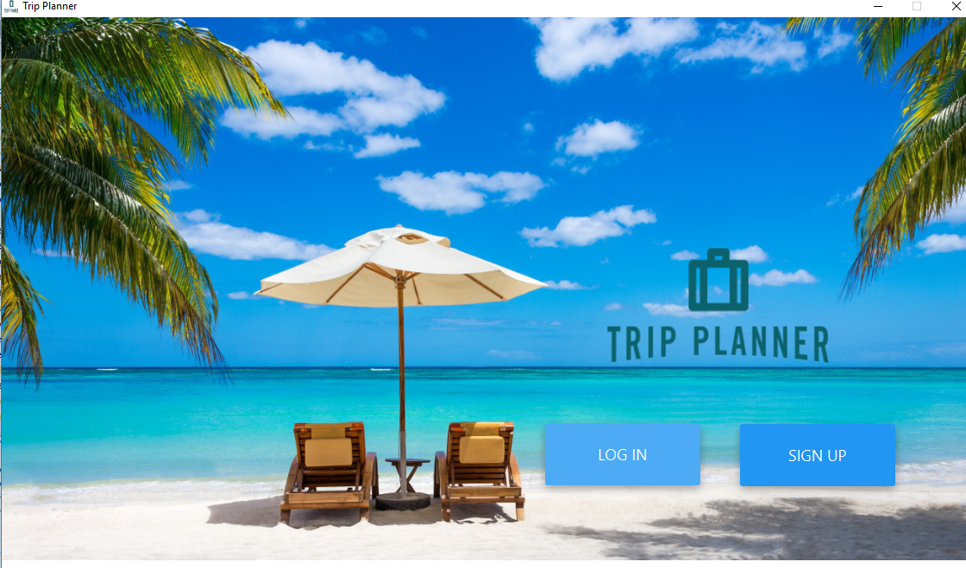
LOGIN

Slide 46
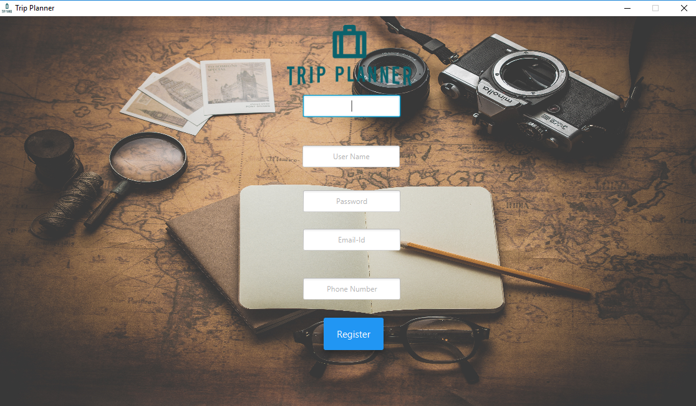
REGISTER

Slide 47
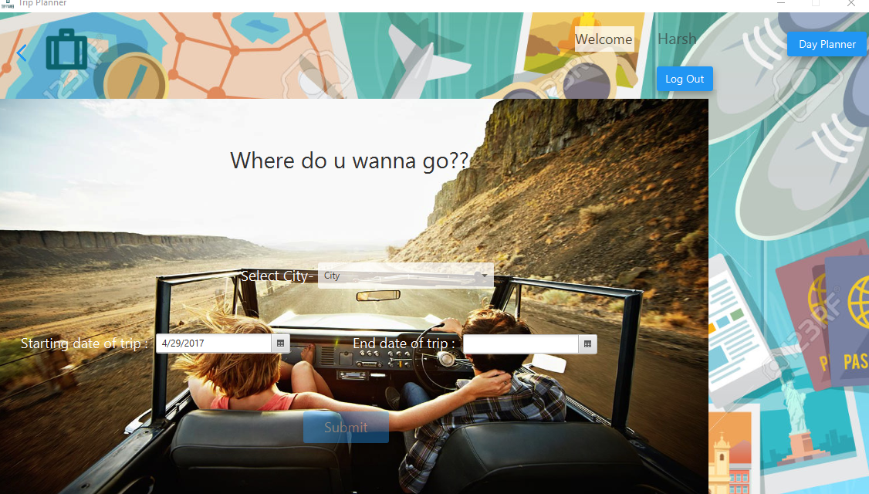
PLANNER

Slide 48
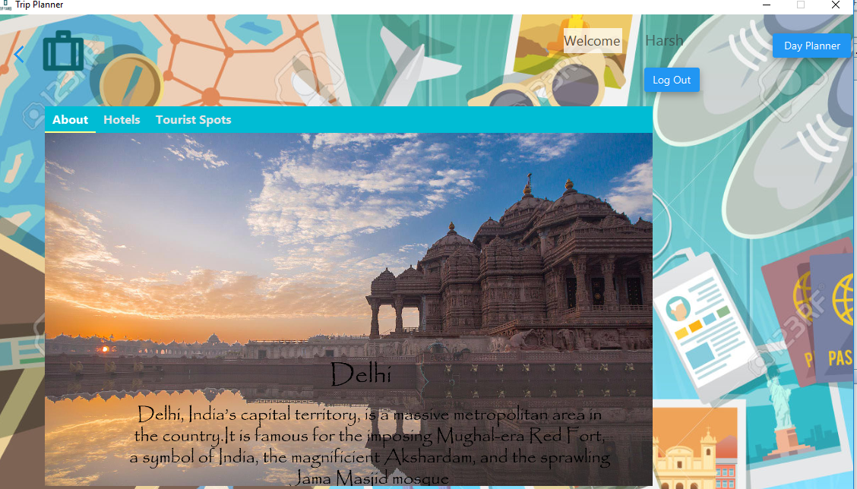
CITY DETAIL

Slide 49
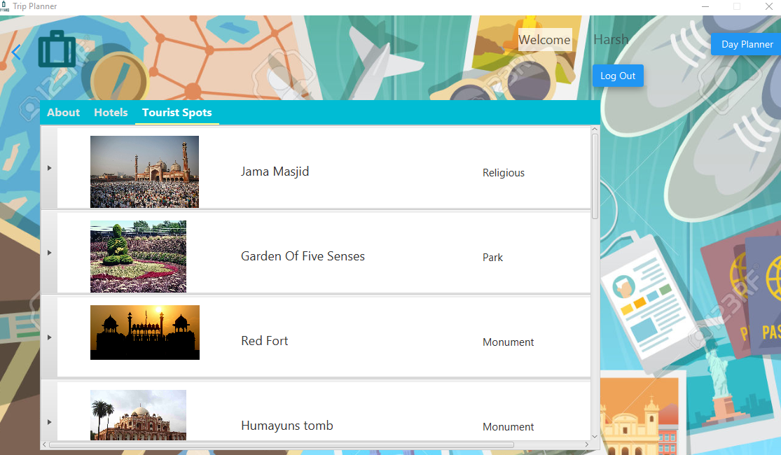
TOURIST PLACE SELECTOR

Slide 50
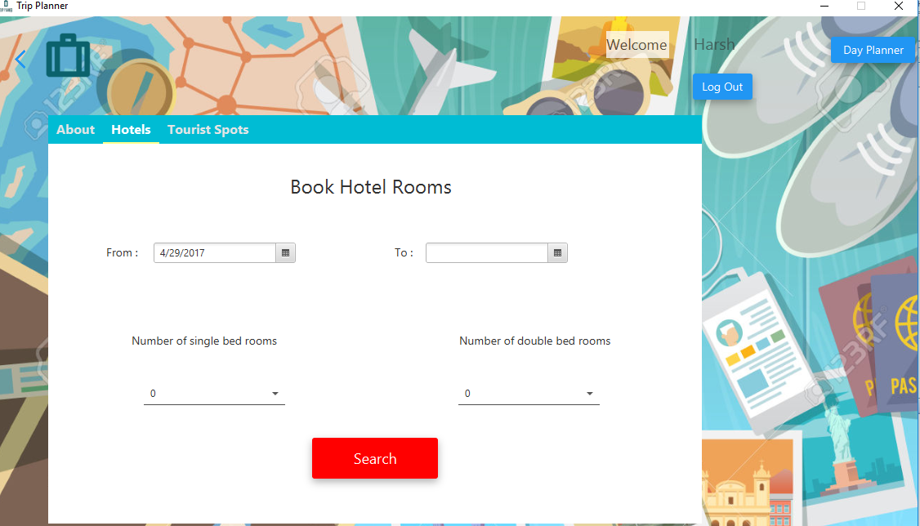
BOOK HOTEL

Slide 51
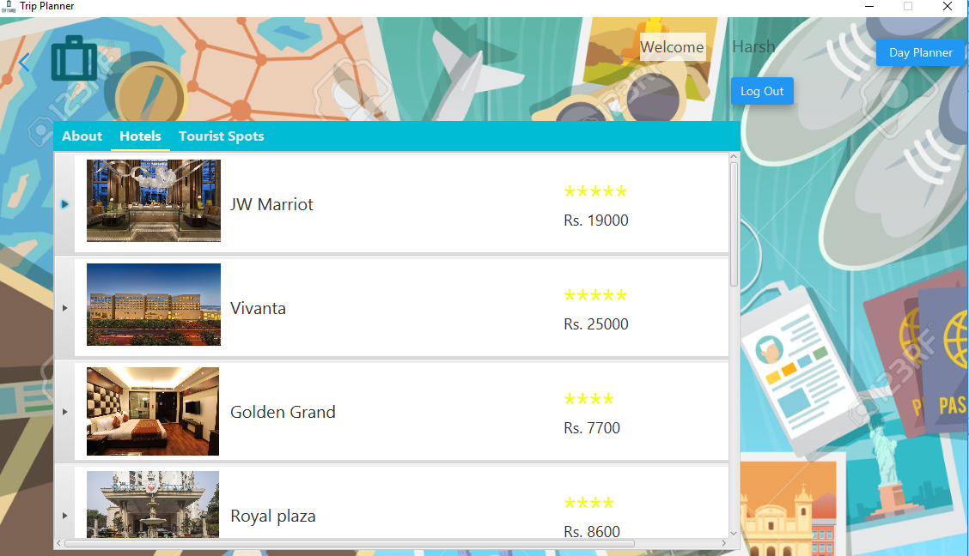
HOTEL SELECTOR

Slide 52
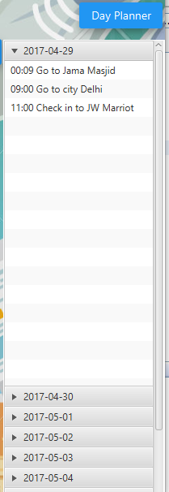
DAY PLANNER

Slide 53
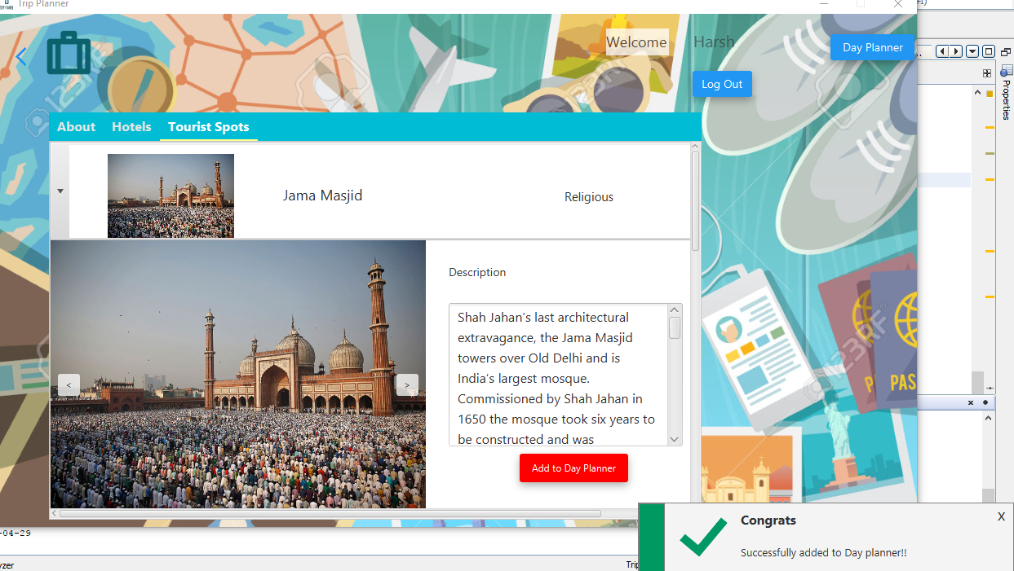
confirmation

Slide 54


